Slide 1
Restaurant Billing System
Internship Project by BroskiesHub By: RESHI PULLA

Slide 2
Introduction
The Restaurant Billing System is a web-based application designed to simplify and automate the billing process in restaurants. It enables users to:
Search and filter menu items quickly.
Add selected items to an order.
Automatically calculate GST (5%) and discounts.
Generate detailed bills in multiple formats (PDF, CSV, JSON).
Store bills locally for future reference and reporting.
This system improves billing accuracy, reduces processing time, and enhances customer experience.

Slide 3
Key Features
🔍 Menu Search & Filters 💳 Multiple Payment Modes
🧮 Automatic GST Calculation 🆔 Bill Auto-Numbering
💰 Discount Support 📄 Multi-Format Export
💾 Local Storage

Slide 4
Tech Stack
Python - Core programming language
Streamlit – Interactive web UI
SQLite – Menu & order data storage
Pandas – Data handling and exports
FPDF/ReportLab – PDF bill generation
JSON/CSV – Structured data storage formats
VS Code – Development environment

Slide 5
Work Flow
📂 Menu Load
🔍 Item Selection
🧮 Billing Calculation
📄 Export & Storage
🧾 Bill Generation
💳 Payment Processing

Slide 6
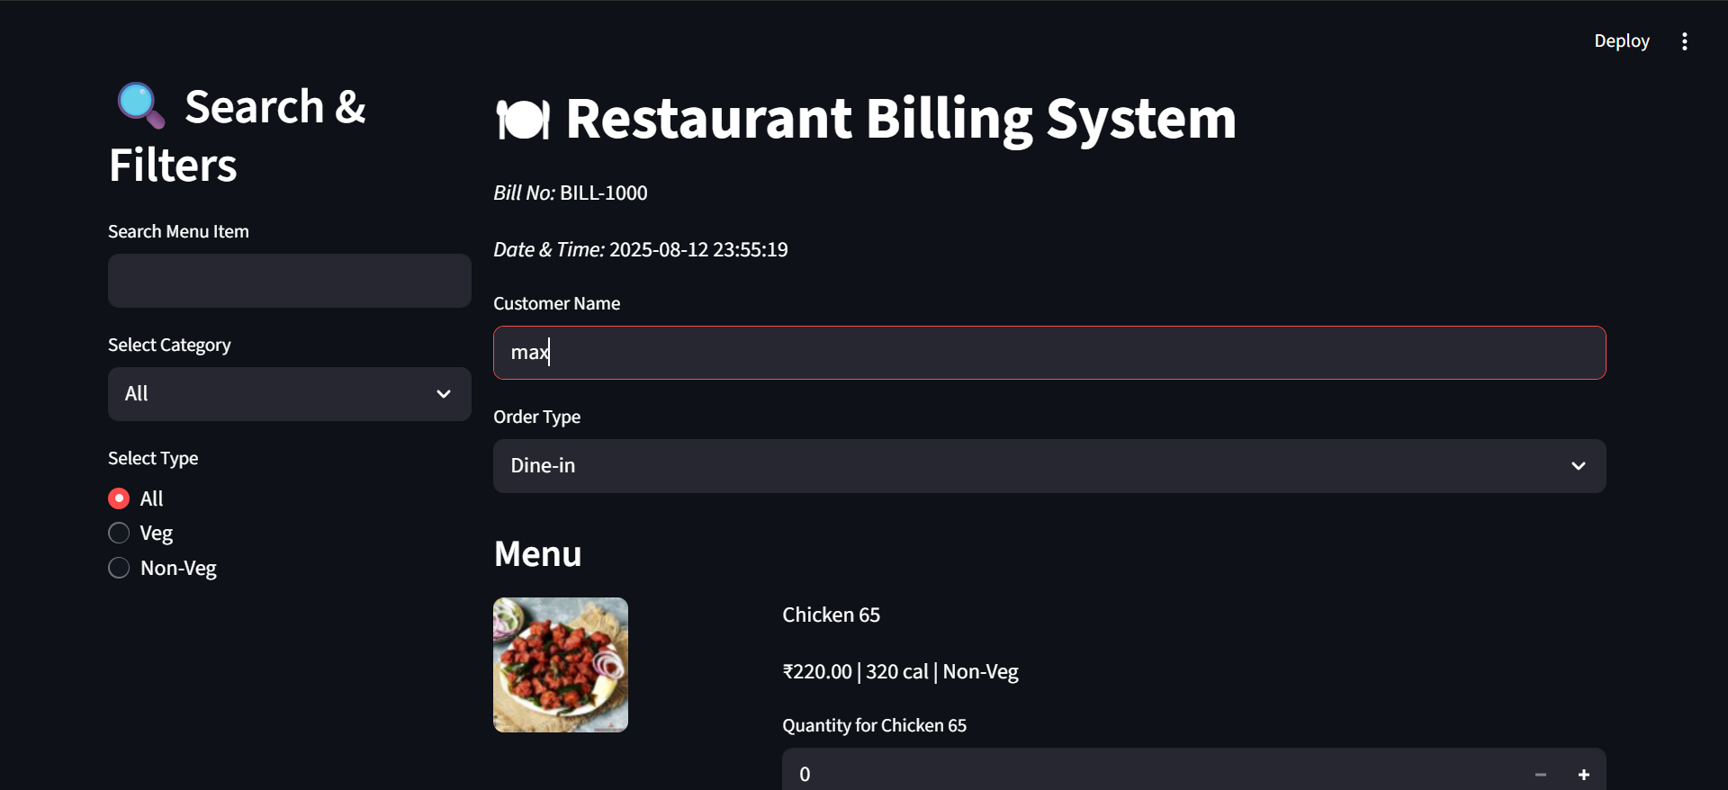
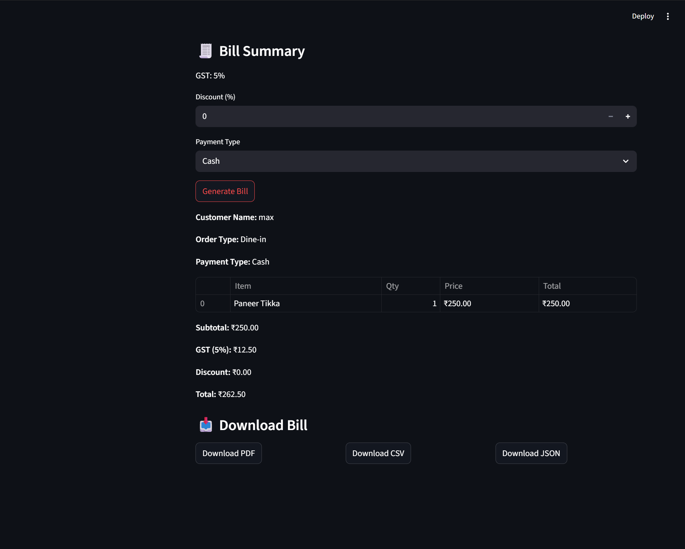
Outputs
Home Page – Item selection, search
Bill Summary – Shows GST, discounts, and final total

Slide 7
Conclusion
The Restaurant Billing System successfully achieves its goal of providing a fast, accurate, and user-friendly billing process for restaurants. By automating menu selection, GST and discount calculation, and multi-format bill generation, it reduces manual errors, saves time, and improves operational efficiency. With its user-friendly interface and reliable performance, the system is well-suited for small to medium-sized restaurants looking to enhance customer satisfaction and streamline their billing operations.

Slide 8
Thank You

